Slide 1













Web Programming
HTML
CSS
JavaScript
Step by step Exercises

Slide 2












HTML
The Web Programming Triangle
Use HTML to define the content of web pages
Web Programming
JavaScript
CSS
Use CSS to specify the layout of web pages
Use JavaScript to program the behavior of web pages

Slide 3



















Web Architecture
Internet Explorer
Chrome
Firefox
Opera
Safari
Client
Web Browser
HTML CSS
JavaScript
Server-side
Web Server

Slide 4











Client-Server Example
Client
Web Browser
Response
Web Server
Request
Database
Internet Information Services (IIS), Apache, etc.

Slide 5







Web Platform
The Web Browser creates the visual web page you see in the browser based on
the HTML code
<!DOCTYPE html>
<html>
<body>
<h1>My First Heading</h1>
<p>My first paragraph.</p>
</body>
</html>
HTML, CSS, JavaScript Client-side
Web Browser
Web Page (HTML)
The code runs on the server and converted to HTML before sending to client (Web Browser)
Web Server
Server-side
ASP.NET, PHP, ...
Internet Information Services (IIS), Apache, etc.

Slide 6



HTML
HyperText Markup Language (HTML)
The Visual Appearnce of a Web Site
“Web Browser Language”: All Web Browser
understand HTML
HTML 5 is the latest
Maintained by W3C
- World Wide Web Consortium
<!DOCTYPE html>
<html>
<head>
<meta charset="UTF-8">
<title>Title of the document</title>
</head>
<body>
Content of the document......
</body>
</html>
13

Slide 7




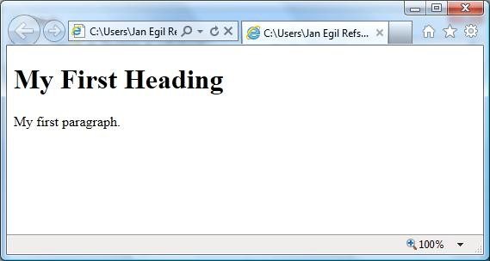
HTML Code
<!DOCTYPE html>
<html>
<body>
HTML
<h1>My First Heading</h1>
<p>My first paragraph.</p>
</body>
</html>
Web Browser
14

Slide 8
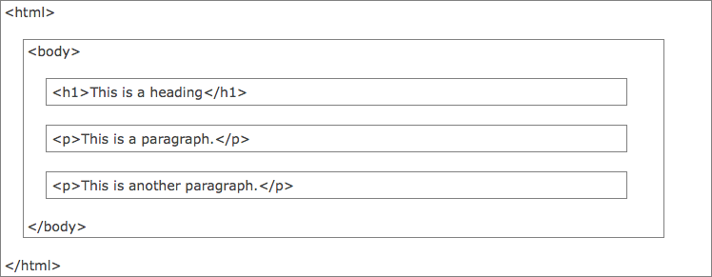



HTML Page Structure
<!DOCTYPE html>
<html>
<body>
<h1>This is a heading</h1>
<p>This is a paragraph.</p>
<p>This is another paragraph.</p>
</body>
</html>
15

Slide 9
HTML Editors
Professional HTML editors:
Adobe Dreamweaver
CoffeeCup HTML Editor
...
For the simple examples in this Tutorial we only need Notepad (Windows) or TextEdit (Mac)

Slide 10







My First HTML Web Page
<tagname>content</tagname>
The DOCTYPE declaration defines the document type
The text between <html> and
</html> describes the web document
The text between <body> and
</body> describes the visible page content
The text between <h1> and </h1> describes a heading
The text between <p> and </p> describes
<!DOCTYPE html>
<html>
<body>
<h1>My First Heading</h1>
<p>My first paragraph.</p>
</body>
</html>
paragraph
Students: Create this HTML Code in e.g., NotePad and Save the File as .htm. Then Open the File in a Web Browser (just double-click on the file).

Slide 11





Hyperlinks
<!DOCTYPE html>
<html>
<body>
<h1>This is a heading</h1>
<a href="http://www.google.com">This is a link to Google</a>
</body>
</html>
<!DOCTYPE html>
<html>
<body>
<h1>This is a heading</h1>
<img src=“myimage.jpg" alt=”blabla" width="104" height="142">
</body>
</html>
Images

Slide 12


















HTML Tags
Hyperlink:
<a href="http://www.google.com">This is a link to Google</a>
Bold Text:
Paragraph:
<b>This is my Text</b>
<p>My first paragraph.</p>
Headers:
Line Break:
<h1>This is my Header</h1>
<h2>This is my Header</h2>
<h3>This is my Header</h3>
This is my Text
<br>
This is also my Text
Title:
Comments:
<title>This is my Title</title>
<!-- Write your comments here -->
Image:
<img src=“myimage.jpg" alt=”blabla" width="104" height="142">
Students: Try these Examples

Slide 13



CSS
CSS – Cascading Style Sheets
Styles define how to display HTML elements
CSS is used to control the style and layout of multiple Web pages all at once
body {
background-color: #d0e4fe;
}
h1 {
color: orange;
text-align: center;
}
p {
font-family: "Times New Roman"; font-size: 20px;
}

Slide 14
Why CSS is needed
HTML was never intended to contain tags for formatting a document.
HTML was intended to define the content of a document, like:
<h1>This is a heading</h1>
<p>This is a paragraph.</p>
When tags like <font>, and color attributes were added to the HTML 3.2 specification, it started a nightmare for web developers. Development of large web sites, where fonts and color information were added to every single page, became a long and expensive process.
To solve this problem, the World Wide Web Consortium (W3C) created CSS.
In HTML 4.0, all formatting could be removed from the HTML document, and stored in a separate CSS file.
All browsers support CSS today.

Slide 15



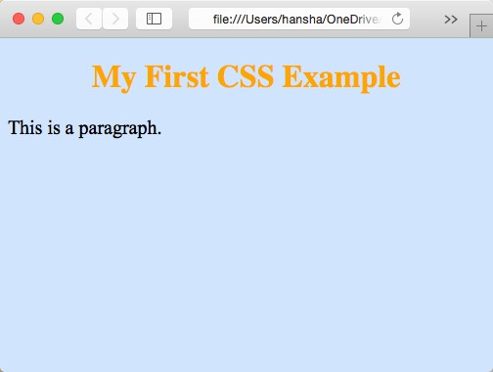

HTML + CSS Example
<!DOCTYPE html>
<html>
<head>
<style> body {
background-color: #d0e4fe;
}
h1 {
color: orange; text-align: center;
}
p {
font-family: "Times New Roman"; font-size: 20px;
}
</style>
</head>
<body>
Students: Create this Code in e.g., NotePad and Save the File as .htm.
Then Open the File in a Web Browser (just double-click on the file).
Change color, etc. and see what happens.
<h1>My First CSS Example</h1>
<p>This is a paragraph.</p>
</body>
</html>

Slide 16
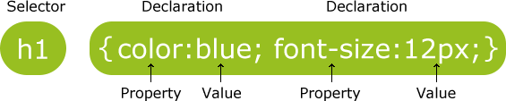


CSS Syntax
A CSS declaration always ends with a semicolon, and declaration groups are surrounded by curly braces, e.g.:
p {color:red;text-align:center;}

Slide 17









CSS Classes
} p.center {
text-align: center; color: red;
}
.center {
text-align: center; color: red;
}
<!DOCTYPE html>
<html>
<head>
<style>
.center {
text-align: center; color: blue;
}
p.center {
text-align: center; color: red;
}
</style>
</head>
<body>
<h1 class="center">My Heading</h1>
<p class="center">My Paragraph</p>
</body>
</html>
<!DOCTYPE
<html>
<head>
<style>
.center {
html>
text-align: color: red;
center;
}
</style>
</head>
<body>
<h1 class="center">My Heading</h1>
<p class="center">My Paragraph</p>
</body>
</html>
Students: Try these Examples

Slide 18
Three Ways to Insert CSS
There are three ways of inserting a style sheet:
External style sheet (Recommended!!)
An external style sheet is ideal when the style is applied to many pages. With an external style sheet, you can change the look of an entire Web site by changing just one file.
An external style sheet can be written in any text editor. The file should not contain any html tags.
The style sheet file must be saved with a .css extension
Internal style sheet
An internal style sheet should be used when a single document has a unique style.
You define internal styles in the head section of an HTML page, inside the <style> tag
Inline style
An inline style loses many of the advantages of a style sheet (by mixing content with presentation). Use this method sparingly!

Slide 19






Internal Style Sheet Example
You define internal styles in the head section of an HTML page, inside the <style> tag, like this:
<head>
<style> body {
background-color: linen;
}
h1 {
color: maroon; margin-left: 40px;
}
</style>
</head>
<!DOCTYPE html>
<html>
<head>
<style>
body {
background-color: linen;
}
h1 {
color: maroon;
margin-left: 40px;
}
</style>
</head>
<body>
<h1>This is a heading</h1>
<p>This is a paragraph.</p>
</body>
</html>
Students: Try this Example

Slide 20






External Style Sheet Example
Each HTML page must include a link to the style sheet with the <link> tag. The
<link> tag goes inside the head section:
<head>
<link rel="stylesheet" type="text/css" href="mystyle.css">
</head>
An example of a style sheet file called “myStyle.css”, is shown below:
body {
background-color: lightblue;
}
h1 {
color: navy; margin-left: 20px;
}
Students: Try this Example

Slide 21















CSS Properties
Text Color
body {
color: blue;
}
h1 {
color: #00ff00;
}
h2 {
color: rgb(255,0,0);
}
Background Color
Text Alignment
body {
background-color: lightblue;
}
h1 {
text-align: center;
}
p.date {
text-align: right;
}
p.main {
text-align: justify;
}
Text Size
h1 {
font-size: 40px;
}
h2 {
Text Font
p {
font-family: "Times New Roman", Times, serif;
}
font-size: 30px;
}
p {
Students: Create a Style Sheet (.CSS) and a HTML page where you use these Properties
font-size: 14px;
}
29

Slide 22
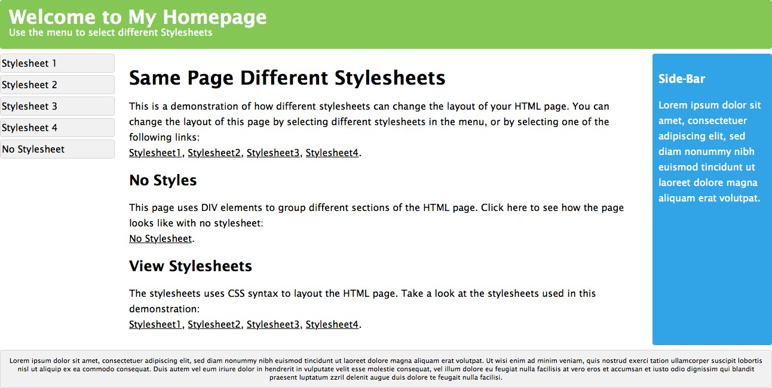
CSS Example
http://www.w3schools.com/css/demo_default.htm
Students: Open this Example and see how different styles totally changes the display and layout of a HTML page

Slide 23
JavaScript
JavaScript is the programming language of the Web.
All modern HTML pages are using JavaScript.
JavaScript is the default scripting language in all modern browsers, and in HTML5.
JavaScript is probably the most popular programming language in the world.
It is the language for HTML, for the Web, for computers, servers, laptops, tablets, smart phones, and more.
JavaScript can Change HTML Elements! – which makes it very powerful!

Slide 24
Why JavaScript?
JavaScript is one of 3 languages all web developers
must learn:
1. HTML to define the content of web pages
2. CSS to specify the layout of web pages
3. JavaScript to program the behavior of web pages
This tutorial is about JavaScript, and how JavaScript works with HTML and CSS.

Slide 25



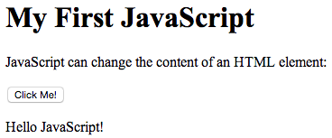
JavaScript Example
<!DOCTYPE html>
<html>
<body>
<h1>
Students: Try this Example
</h1>
<p>
</p>
<button type="button" onclick="myFunction()">
<p id="demo"> </p>
<script>
</button>
</script>
</body>
</html>

Slide 26




JavaScript Example 2
<!DOCTYPE html>
<html>
<body>
<p>Please input a number between 1 and 10:</p>
<input id="numb" type="number">
<button type="button" onclick="myFunction()">Submit</button>
<p id="demo"></p>
<script>
function myFunction() { var x, text;
// Get the value of input field with id="numb" x = document.getElementById("numb").value;
// If x is Not a Number or less than one or greater than 10 if (isNaN(x) || x < 1 || x > 10) {
text = "Input not valid";
} else {
text = "Input OK";
}
document.getElementById("demo").innerHTML = text;
}
</script>
Students: Try this Example
</body>
</html>

Slide 27











JavaScript Comments
// Change heading: document.getElementById("myH").innerHTML = "My First Page";
// Change paragraph:
document.getElementById("myP").innerHTML = "My first paragraph.";
var x = 5; // Declare x, give it the value of 5 var y = x + 2; // Declare y, give it the value of x + 2
/*
The code below will change the heading with id = "myH” and the paragraph with id = "myP” in my web page:
*/
document.getElementById("myH").innerHTML = "My First Page";
document.getElementById("myP").innerHTML = "My first paragraph.";
Using Comments to Prevent Execution:
//document.getElementById("myH").innerHTML = "My First Page"; document.getElementById("myP").innerHTML = "My first paragraph.";
/*
document.getElementById("myH").innerHTML = "My First Page"; document.getElementById("myP").innerHTML = "My first paragraph.";
*/

Slide 28

JavaScript Placement
You can place any number of scripts in an HTML document. Scripts can be placed in the <body>, or in the <head> section of an HTML page, or in both.
It is a good idea to place scripts at the bottom of the
<body> element. This improves page load, because HTML loading is not blocked by scripts loading.
Scripts can also be placed in external files. External scripts are practical when the same code is used in many different web pages. JavaScript files have the file extension .js.

Slide 29
Web Server
The term web server can refer to either the hardware (the computer) or the software (the computer application) that helps to deliver web content that can be accessed through the Internet.
The most common use of web servers is to host websites, but there are other uses such as gaming, data storage or running enterprise applications.
IIS - Internet Information Services
Microsoft Windows
Apache Web Server
Open Source
Cross-platform: UNIX, Linux, OS X, Windows, ...
Nginx (pronounced "engine x") - Has become very popular latly
GWS (Google Web Server)
...

Slide 30
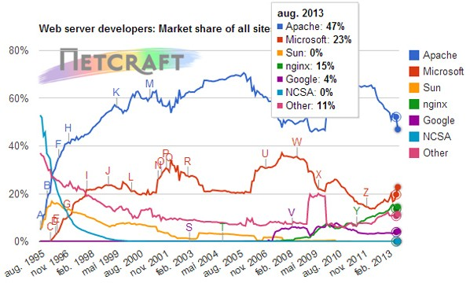
Web Server Popularity
http://www.digi.no/921119/under-halvparten-bruker-apache

Slide 31
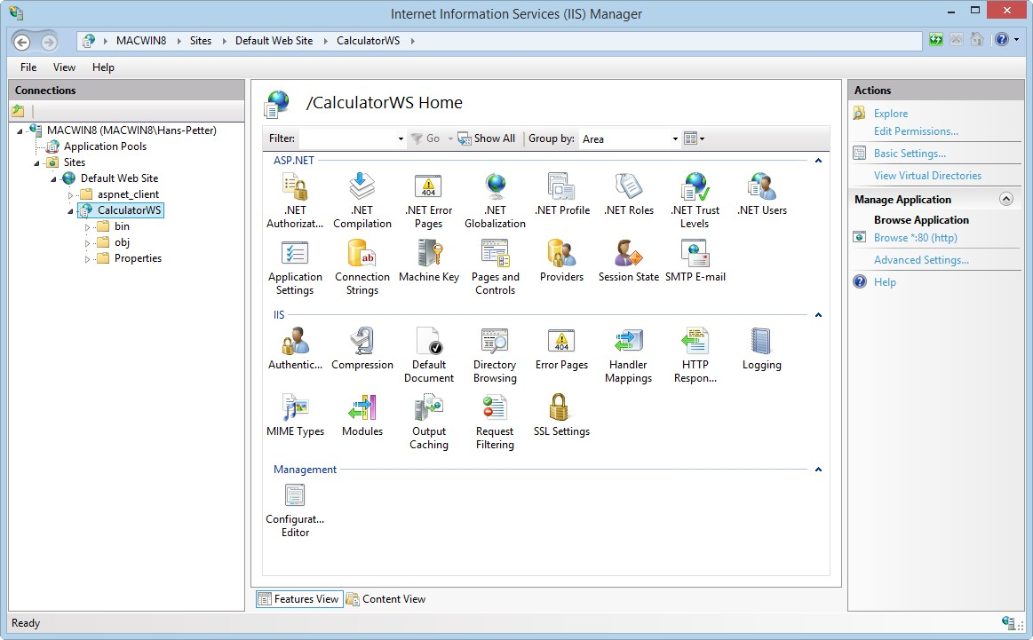



Internet Information Services (IIS)
IIS – Internet Information Services
Web Server that host the Web Pages/Web Site
Make sure to have the IIS Role installed with ASP.NET sub components
Default IIS Directory: C:\inetpub\wwwroot
Students: Deploy one (or) more of your Web pages using IIS

Slide 32



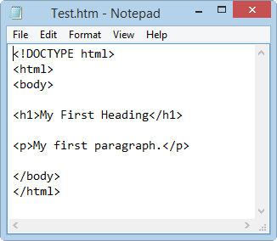
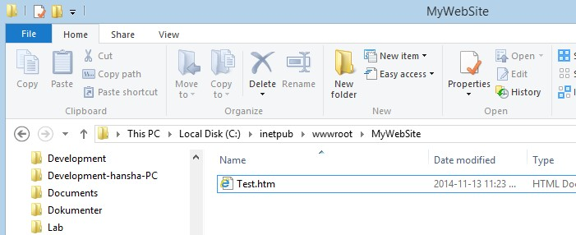


IIS Deployment
<!DOCTYPE html>
<html>
<body>
<h1>My First Heading</h1>
<p>My first paragraph.</p>
</body>
</html>

Slide 33
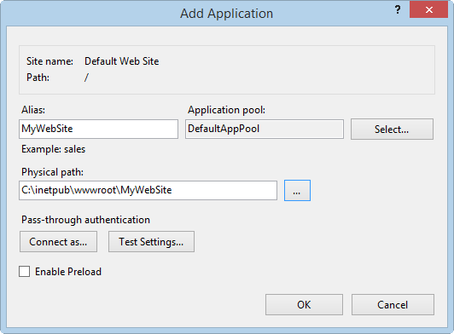
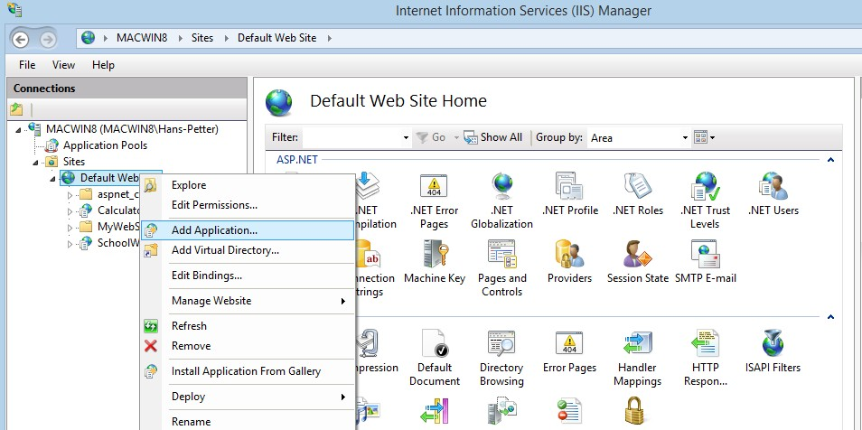




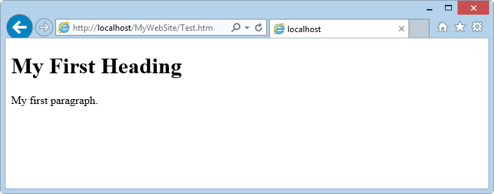







IIS Deployment
Test your Web Page in your Web browser
“localhost” is your personal computer, you cam also use your IP address.

Slide 34
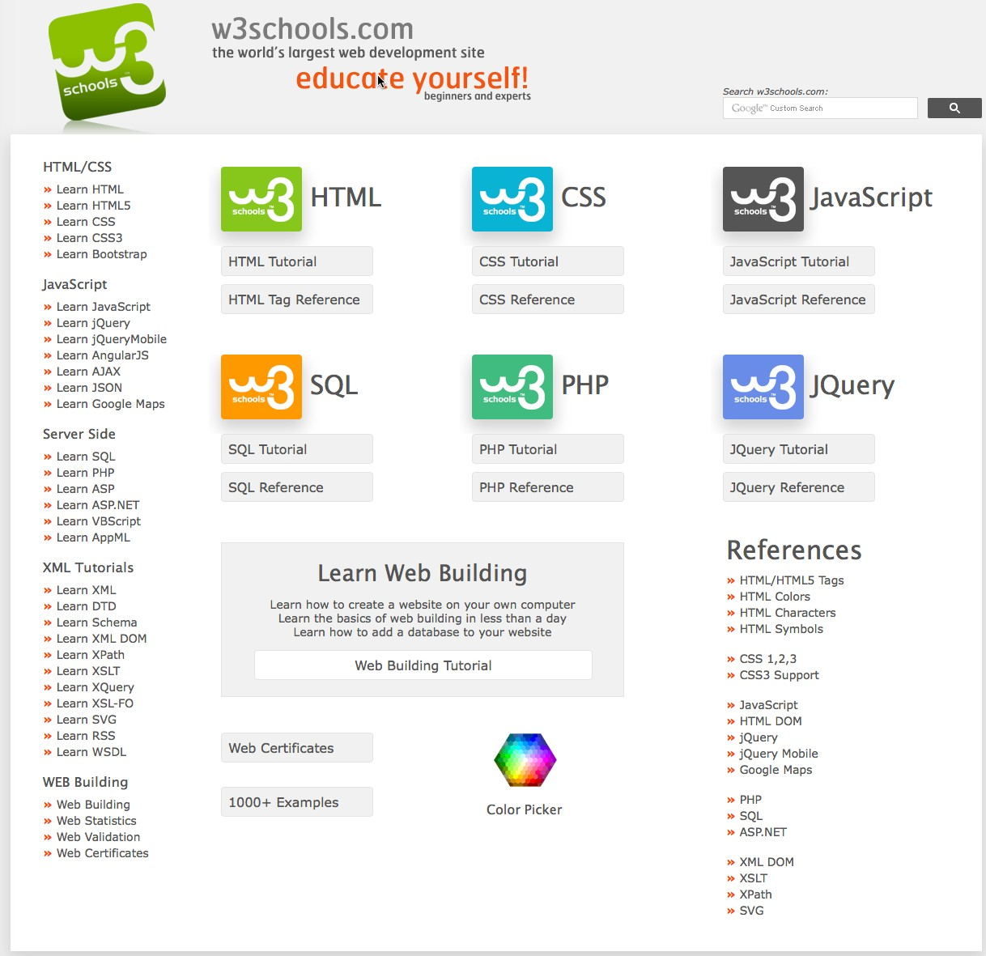
http://www.w3schools.com

Slide 35




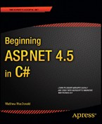





eBooks from Safari Books Online
http://proquest.safaribooksonline.com/?uicode=telemark
...

Slide 36
References
HTML Tutorial: http://www.w3schools.com/html
CSS Tutorial: http://www.w3schools.com/css
JavaScript Tutorial: http://www.w3schools.com/js

